Slide 1
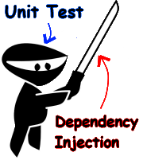
Design for Testability

Slide 2
Discussion – a general problem
Test code
All test involves interaction
with the Unit Under Test
(UUT)
UUT
Either directly, by monitoring responses (values) or resulting state.
Dependencies
Or indirectly, by monitoring
how the UUT interacts with its dependencies

Slide 3
Testing a class
Testclass TestA wants to test A::methodA
methodA calls objB.methodB
The test fails!
Where is the error?

Slide 4
Design for Testability - dependencies
In order to test a functionality of a class, we first need to detach it from the rest of system in which it is designed to work. We then need to create an instance from that class, activate the tested functionality and finish by making sure the resulting behavior matches our expectations.
However, unless the system is designed specifically to enable this, in most cases, it will not be simple.
Gil Zilberfeld, http://www.infoq.com/articles/Testability

Slide 5
Towards controlling dependencies
A testable design allows us to detach a single class (the UUT) from the rest of the system.
Then, we can control which dependencies the UUT uses, e.g. our “fake” versions of the dependencies
There are 3 steps towards control (III or Triple-I):
  IDENTIFY Identify the external dependency
  INTERFACE Introduce an interface (TAOUT: a seam) at the dependency
  INJECT Replace (inject) the dependency

Slide 6
1: Identify the dependencies
class House
{
private readonly Bedroom _bedroom;
private readonly Kitchen _kitchen;
private readonly FrontDoor _door;
public House()
{
_bedroom = new Bedroom();
_kitchen = new Kitchen();
_door = new FrontDoor();
}
public void Leave()
{
_kitchen.ShutDownAllAppliances();
_bedroom.TurnLightOff();
_door.Lock();
}
}
Where are the
dependencies?
What is the problem?
What is the design flaw?

Slide 7
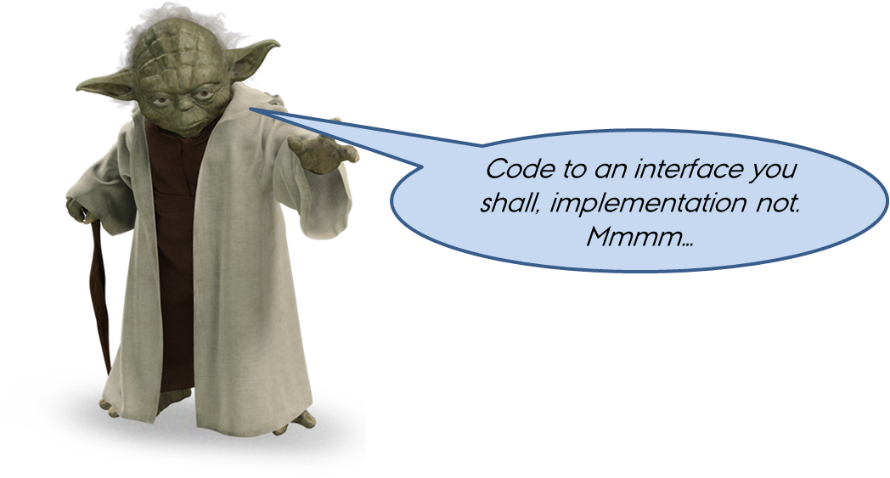
2: Interface – Loosen the coupling
We can loosen the coupling by introducing interfaces to the dependencies

Slide 8
2: Interface – Loosen the coupling
What does House really want to do with the Bedroom?
“To call TurnLightOff() on its Bedroom object”, or
“To turn the light off in the bedroom”
How can interfaces help us?
Where do the interfaces go?
How does this further testability?

Slide 9
2: Interface – Loosen the coupling

Slide 10
2: Interface – Loosen the coupling
class House
{
private readonly IBedroom _bedroom;
private readonly IKitchen _kitchen;
private readonly IFrontDoor _door;
public House()
{
_bedroom = new Bedroom();
_kitchen = new Kitchen();
_door = new FrontDoor();
}
public void Leavehouse()
{
_kitchen.ShutDownAllAppliances();
_bedroom.TurnLightOff();
_door.Lock();
}
}
Are we happy now?

Slide 11
2: Interface – Loosen the coupling
Make fakes!

Slide 12
2: Interface – Loosen the coupling
// *** Production code ***
class House
{
private readonly IBedroom _bedroom;
private readonly IKitchen _kitchen;
private readonly IFrontDoor _door;
public House()
{
_bedroom = new Bedroom();
_kitchen = new Kitchen();
_door = new FrontDoor();
}
public void Leavehouse()
{
_kitchen.ShutDownAllAppliances();
_bedroom.TurnLightOff();
_door.Lock();
}
}
// *** Test code ***
class House
{
private readonly IBedroom _bedroom;
private readonly IKitchen _kitchen;
private readonly IFrontDoor _door;
public House()
{
_bedroom = new FakeBedroom();
_kitchen = new FakeKitchen();
_door = new FakeFrontDoor();
}
public void Leavehouse()
{
_kitchen.ShutDownAllAppliances();
_bedroom.TurnLightOff();
_door.Lock();
}
}
Change production code to test it - ☹

Slide 13

3: Inject dependency
We would like to control the type of dependencies that House uses.
  Fake dependencies or real dependencies
We do this by injecting the dependencies into House.
  Remember: Since House uses interfaces to its’ dependencies, it does not care about their concrete types
  So instead of letting House construct it’s own dependencies, we inject them into House
  This means that we can isolate House from the
  rest of the system!

Slide 14
3: Constructor injection
class House
{
private readonly IBedroom _bedroom;
private readonly IKitchen _kitchen;
private readonly IFrontDoor _door;
// Constructor injection
public House (
IBedroom bedroom,
IKitchen kitchen,
IFrontDoor door)
{
_bedroom = bedroom;
_kitchen = kitchen;
_door = door;
}
public void Leavehouse()
{
_kitchen.ShutDownAllAppliances();
_bedroom.TurnLightOff();
_door.Lock();
}
}
// Production
class Program
{
static void Main(string[] args)
{
// Use constructor injection to inject reals
var house = new House(
new Bedroom(),
new Kitchen(),
new FrontDoor()
);
}
}
// Test
[Test]
public void House_Ctor_ConstructorInj()
{
// Use constructor injection to inject fakes
var uut = new House(
new FakeBedroom(),
new FakeKitchen(),
new FakeFrontDoor());
}
House remains unchanged

Slide 15
3: Property injection
public class House
{
// Properties allow property injection
public IBedroom Bedroom { private get; set; }
public IKitchen Kitchen { private get; set; }
public IFrontDoor Door { private get; set; }
public House()
{
// Initialize dep’s – may be overwritten
// later
Bedroom = new Bedroom();
Kitchen = new Kitchen();
Door = new FrontDoor();
}
public void Leavehouse()
{
Kitchen.ShutDownAllAppliances();
Bedroom.TurnLightOff();
Door.Lock();
}
// Production
class Program
{
static void Main(string[] args)
{
// Use default properties (reals)
var house = new House();
}
}
// Test
[Test]
public void House_Ctor_PropertyInj()
{
var uut = new House();
// Use property injection to inject fakes
uut.Bedroom = new FakeBedroom();
uut.Kitchen = new FakeKitchen();
uut.Door = new FakeFrontDoor();
}
Problemer: 1) Hvis klassen selv oprette dep. i constr. kan de udføre ting, der ikke kan tilbageføres selvom man overskriver dep!
2) Der skal som minimum være en skalimplementering af dep. for at de kan oprettes!

Slide 16
The invisible dependencies!
At some point, we must consider the real world in our system
Classics are “uncontrollable” dependencies
  Time, file system, console, randomness, external hardware and its drivers, …
We do not omit dependency inclusion, we defer it!
  During unit testing (and initial integration testing), we isolate the use of these dependencies as much as possible
  When time comes, we can integrate external dependencies with a high degree of confidence

Slide 17
Example of uncontrollable external dependencies
How can we test this:
Anytime?
Automatically?
public class House
{
public void CloseHouse()
{
// If after bedtime – close down house
if (System.DateTime.Now.Hour > 22)
{
  Kitchen.ShutDownAllAppliances();
  Bedroom.TurnLightOff();
  Door.Lock();
  // Log the event
  System.Console.WriteLine("House closed down");
}
Wait until after 22:00 but before 00:00?
Using picture analysis on a camera picture of the console?

Slide 18
Solving uncontrollable external dependencies
Encapsulation!

Slide 19
Solving uncontrollable external dependencies
public class House
{
public House (
IBedroom bedroom,
IKitchen kitchen,
IFrontDoor door,
ITimeProvider timep,
Ilogger logger)
{
_bedroom = bedroom;
_kitchen = kitchen;
_door = door;
_timeProvider = timep;
_logger = logger;
}
public void Leavehouse()
{
// If after bedtime – close down house
if (_timeProvider.getHour() > 22)
{
  Kitchen.ShutDownAllAppliances();
  Bedroom.TurnLightOff();
  Door.Lock();
  // Log the event
  _logger.WriteLogLine("House closed down");
  }
}
Then injection

Slide 20
Recap
A sensible design is required for testability
Primary concern:
  Dependencies = Loss of control
Other concern:
  Dependencies = Errors cannot be located
Gain control by designing for loose coupling - III
  Identify the dependency
  Introduce an interface (seam) for the dependency
  Inject the dependency

Slide 21
Design principles and patterns for
Design for Testability
Low coupling
  III – design with interfaces
  Use Observer Pattern
    In C# this is normally done with C# events and delegates
  Use Exceptions (but not for normal return of data!)
Single responsibility
  Reduces the number of internal states
  Makes the code simpler!
  Makes testing simpler!
  Refactor
    Use the tests to ensure you did it right!
See also section 11.2 of TAOUT for C# recommendations

Slide 22
Symptoms of wrong design
How hard is it to write the test?
If the tests are hard to write, maybe the design is wrong!
The test is the first client – what about the actual final client : other finished classes and components?
If the tests are hard to write, it may be hard to use the unit!
Listen to the test

Slide 23


